Slide 1

Making the publication treadmill more fun by using R - accessible spreadsheets with the openXLSX package
Maike Waldmann (she/her)
R User Day 2021

Slide 2
Overview
Briefly: poverty and wealth reports on data.gov.scot
Accessible spreadsheets with openxlsx:
the basics: create spreadsheet
customise: make it look nice
automate: some ideas

Slide 3
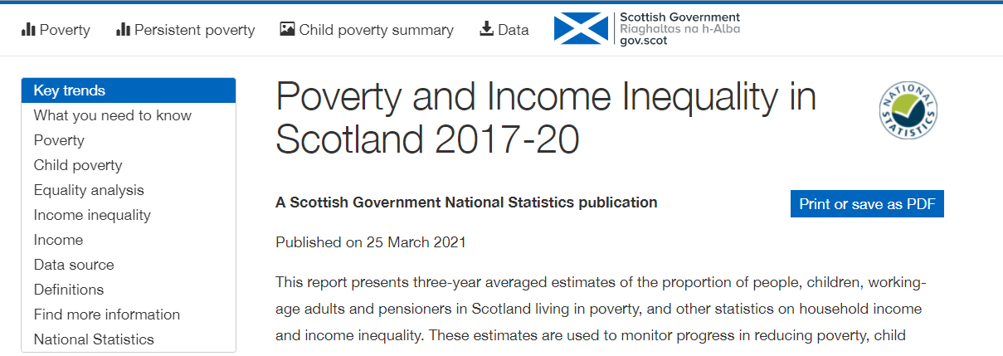
Automated poverty reports
https://data.gov.scot/poverty:

Slide 4
MY usual Project setup
myproject
R
data
output
Project folder, has .Rproj file and subfolders – tidy!
R scripts
data = your input data (sas7bdat, xls, csv, rds, ...)
output = your outputs (xls, ods, png, svg, html, …)
data
.R
.R .R
.R
output

Slide 5
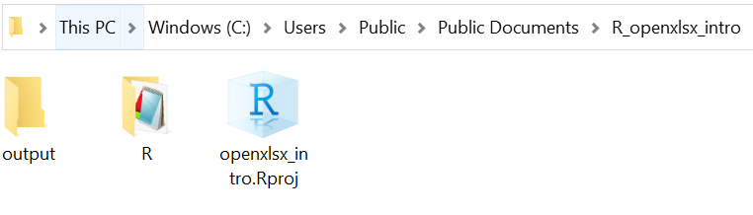
Today’s setup

Slide 6
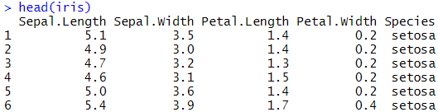
iris dataset
library(tidyverse)
head(iris)

Slide 7
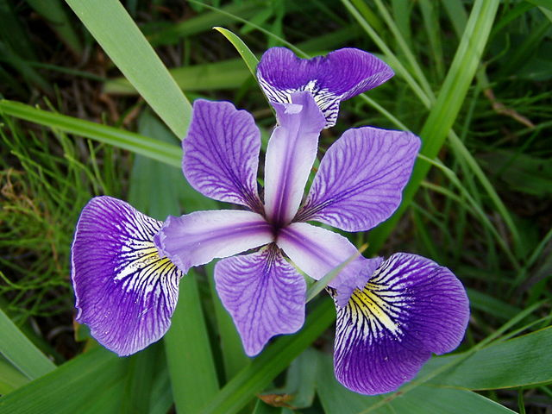
IRIS
Irises have 3 petals and 3 sepals.
But which is which?
Iris versicolor from Iris flower data set - Wikipedia

Slide 8
data wrangling
table <- iris %>%
group_by(Species) %>%
summarise(Sample = n(),
Petal_length_mean = mean(Petal.Length),
Sepal_length_mean = mean(Sepal.Length)) %>%
mutate(Ratio_S_P = Sepal_length_mean/Petal_length_mean,
Ratio_S_P = round(Ratio_S_P, 2),
Petal_length_mean = round(Petal_length_mean, 1),
Sepal_length_mean = round(Sepal_length_mean, 1) )

Slide 9
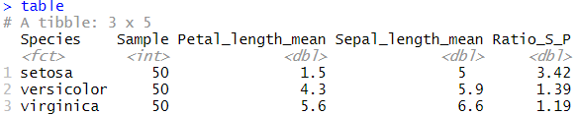
R output

Slide 10
petals and sepals
Irises have 3 petals and 3 sepals.
Sepals are longer.
Iris versicolor from Iris flower data set - Wikipedia

Slide 11
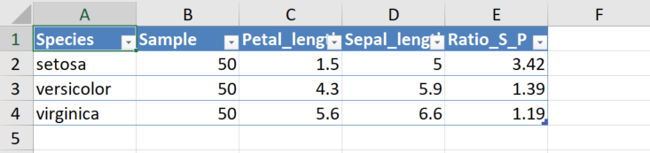
create spreadsheet – qUick way
library(openxlsx)
write.xlsx(table, "output/iris_table_quick.xlsx", asTable = TRUE)

Slide 12
create spreadsheet – LONG way
wb <- createWorkbook()
addWorksheet(wb, "Iris_table")
writeData(wb, "Iris_table",
"Mean petal and sepal lengths by iris species")
writeDataTable(wb, "Iris_table", table, startRow = 2)
# writeData(wb, "Iris_table", table, startRow = 2) works too, but inaccessible
saveWorkbook(wb, 'output/iris_table_long.xlsx', overwrite = TRUE)

Slide 13
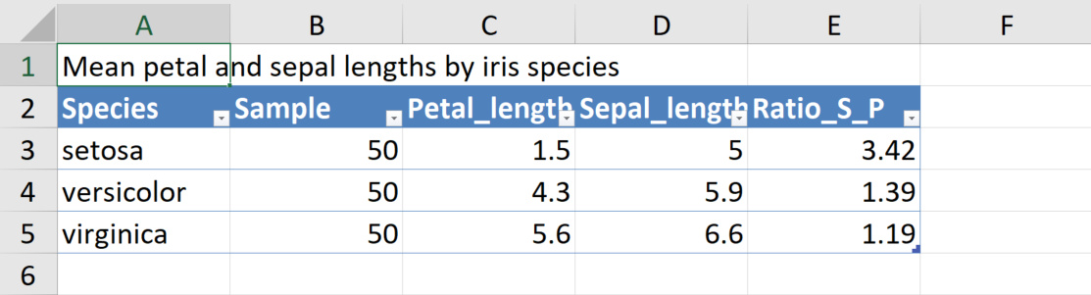
LONG way

Slide 14
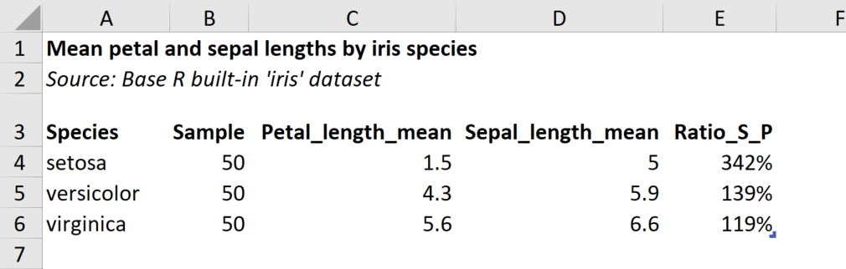
Make table look nice

Slide 15
Customise
# no gridlines
addWorksheet(…, gridLines = FALSE)
# format: bold, italic, right-aligned, percent-format, …
addStyle(…, createStyle(textDecoration = "bold“, numFmt = "0%“, halign = “right))
# simplify table style
writeDataTable(…, tableStyle = "none", withFilter = FALSE)
# adjust column widths
setColWidths(…, cols = 2:ncol(table), widths = "auto")
# adjust row height
setRowHeights(…, rows = 3, heights = 25)

Slide 16
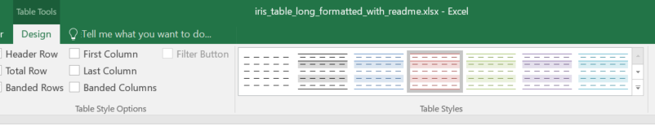
Table styles
To find Excel style names: click on your table -> Design -> Table Styles (hover over each to get name (“Table Style Light 3”), remove spaces:
writeDataTable(…, tableStyle = “TableStyleLight3“, …)

Slide 17
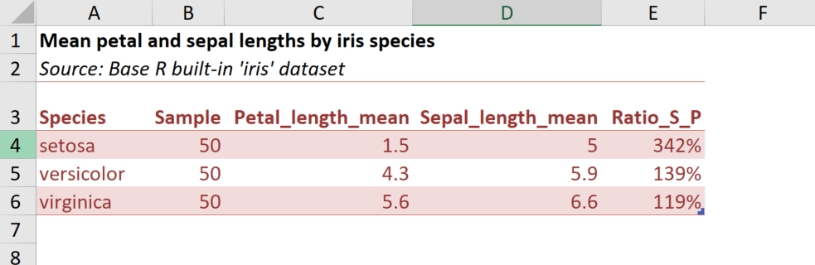
Table Style Light 3

Slide 18
Add more worksheets
wb <- createWorkbook()
addWorksheet(wb, "Readme")
addWorksheet(wb, "Contents")
addWorksheet(wb, "Notes")
addWorksheet(wb, "Iris_table")
saveWorkbook(wb, 'output/iris_table_long.xlsx', overwrite = TRUE)

Slide 19
Add just text
wb <- createWorkbook()
…
addWorksheet(wb, "Readme")
writeData(wb, "Readme",
c("Readme",
"This document contains a simple example of an accessible table.",
"There isn't a lot more to say",
"Add as many lines as you want."))
addStyle(wb, "Readme", rows = 1, cols = 1,
createStyle(textDecoration = "bold"))
…
saveWorkbook(wb, 'output/iris_table_long.xlsx', overwrite = TRUE)

Slide 20
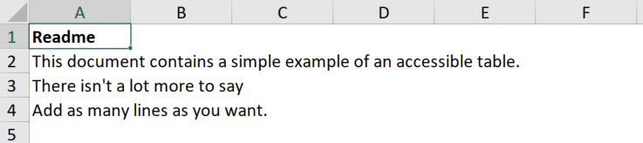
READme sheet
Readme worksheet

Slide 21
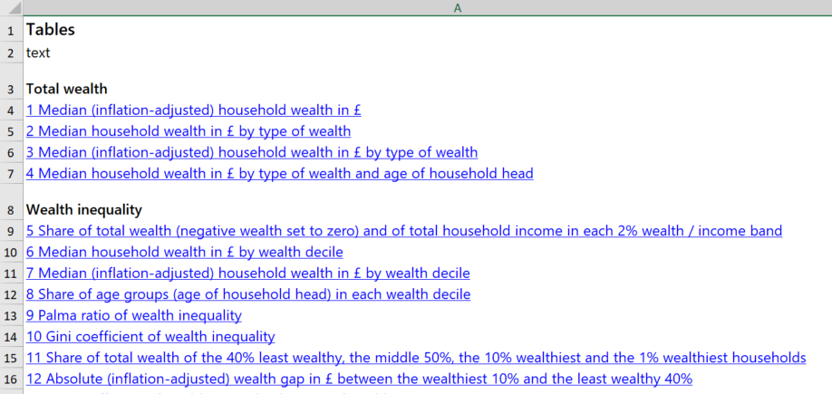
Auto TOC example

Slide 22
You can also…
add multiple tables to a worksheet (but more difficult to make them accessible)
add borders and colours (but watch out for contrast, and make sure text colour is set to auto)
automate more, if you have many similar tables: use functions to loop through all tables in a list that should go into a worksheet
include hyperlinks
My code tends to end up verbose when using openxlsx.

Slide 23
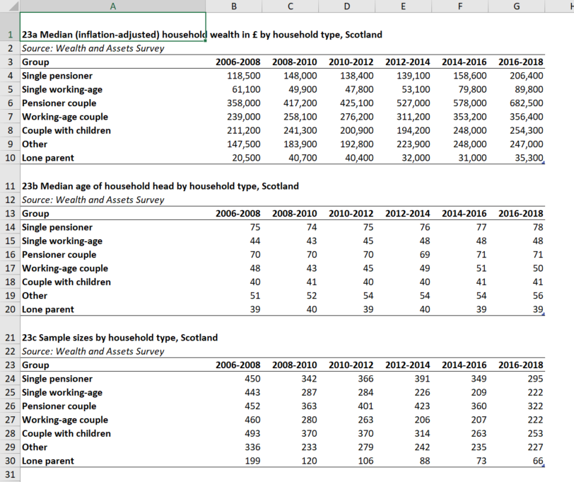
Multiple tables example
Table a) Median wealth by hhld type
Additional tables for context:
Table b) Median age
Table c) Sample sizes

Slide 24
BONUS: ODS
An R script that uses VBA to create ods versions of all compatible xlsx files in your data folder. (what’s compatible: Differences between the OpenDocument Spreadsheet (.ods) format and the Excel for Windows (.xlsx) format (microsoft.com))
You need 3 files:
‘xlsx_to_ods.R’ in your R folder
‘Run Excel Macro.vbs’ in your project folder
‘VBA – Convert XLSX to ODS.xlsm’ in your project folder
Make your project folder a “Trusted location” for Office: Add, remove, or change a trusted location (microsoft.com)
With thanks to Neil Perkins (PHS) and Andrew Waugh (SG)

Slide 25
xlsx_to_ods.R
system_command <- paste("WScript", '"Run Excel Macro.vbs"', sep = " ")
system(command = system_command, wait = TRUE)
print("ods. files have been saved to /output")

Slide 26
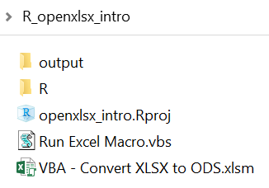
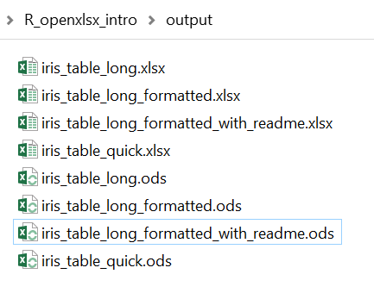
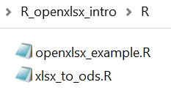
NEW setup

Slide 27

Resources
All files used in this presentation:
github.com/DataScienceScotland/openxlsx_intro
Email me to set up a chat about R, RAP, html, styling, my data.gov.scot experiences: maike.waldmann@gov.scot
Accessible spreadsheets guidance: Releasing statistics in spreadsheets – GSS (civilservice.gov.uk) (also has excellent Youtube tutorial)

Slide 28
thank you
All code for https://data.gov.scot/poverty:
github.com/DataScienceScotland/poverty-publications
Template for creating a website with SG branding:
github.com/DataScienceScotland/poverty_template
Code for https://data.gov.scot/wealth (to be updated in February):
github.com/DataScienceScotland/wealthreport

